Slide 1
NGSE International – ARCHITECTURE & DESIGN
Data & Analytics Engineering
December 12th, 2022

Slide 2















NGSE INTERNATIONAL Design & Architecture Diagram
Zoetis Subscription
GitHub Zoetis-NGSE-Int
Azure Portal
Touchpoint
Zoetis Tenant
DDP Governed (ADLS)
Keyvault
Azure Active Directory
Azure App Service Plan
Azure Application Insights
Repo: Tools (only one repo)
For Frontend / Backend deployment Data Pipeline
SAMI
SAMI
SAMI
Azure Data Factory
Azure Databricks
DNA-Data (ADLS Gen2)
Virtual Machine (Python Data Pipelines)
PostgreSQL
Azure App Service (Python)
SAMI
azadmin
Control-M Job Scheduler
Azure Active Directory
Zoetis Users

Slide 3

NGSE INTERNATIONAL Data Flow Diagram
SFDC
Service Cloud
DDP
Five9
NGSE
DNA-Data
Postgres
Hybris
Governed
SAP
Azure Active Directory
Azure App Service (Python)
Simplement
Touchpoint
RDM
Manual Files
Zoetis Users

Slide 4
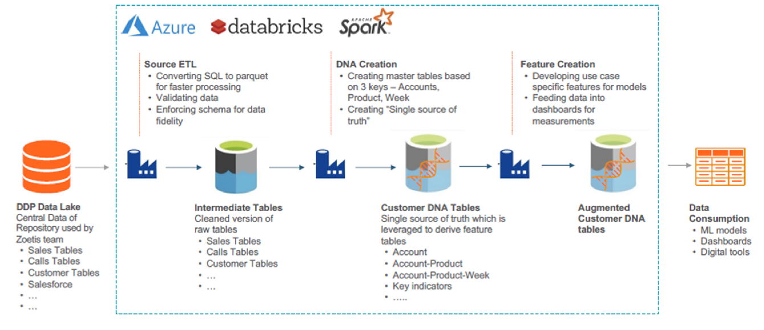
NGSE INTERNATIONAL DNA Architecture

Slide 5

Touchpoint
DDW / ZIR
DDP (ADLS)
Intermediate (ADLS)
Transform
Governed
- account
- asset
- attendee
- call
- case
- casecomment
- casefeed
- campaign
- campaign_member
- contact
- et4ae5__IndividualEmailResult
- eu_account_affiliation
- eu_account_position
- eu_campaign_account
- eu_discussion
- eu_employee_call_credit
- eu_position
- eu_species_product
- eu_territory
- Opportunity
- Survey_Response__c
- user
- us_event_account
- us_event_product
- ZTS_Events__c
- dim_Contract
- dim_Customer
- fact_Contracts_Signed
- rpt_Customer_GSA_Hierarchy
- Direct_Sales.csv
- Indirect_Sales.csv
- JPN_Indrct_sls_Price.csv
- PROD_HIER_NEW.csv
- exchange_rates.csv
- Product Hierarchy AUS FINAL.csv
- REP_ACCOUNTS_CALL_TGT_ DAYS_OVERDUE_EXCLUDE_SLS.csv
- Zoetis_Rewards_A_Series_Cust_ AUS.csv
- ACCOUNT_POTENTIAL.csv
- NGSE_ZOETIS_REWARDS_LIST_ PRICE.csv
- Zoetis_Rewards_Customers.csv
- Market_lkp.csv
- NGSE Product Hierarchy with ESO (Canada).csv
- Account_Product_Blacklist_CAN.csv
- ProductMasterFileforNGSE.csv
- tbl_vw_direct_sales
- tbl_vw_indirect_sales
- tbl_vw_indirect_sales_jpn
- tbl_vw_product
- tbl_vw_account
- tbl_vw_call
- tbl_vw_eu_position
- tbl_vw_eu_territory
- tbl_vw_campaign
- tbl_vw_campaign_member
- tbl_vw_user
- tbl_vw_asset
- tbl_vw_exchange_rate
- tbl_vw_case
- tbl_vw_product_hr
- tbl_vw_contact
- tbl_vw_attendee
- tbl_vw_rep_account_calls
- tbl_vw_zoetis_flag
- tbl_vw_account_potential
- tbl_vw_market_list
- tbl_vw_product_hr_can
- tbl_vw_dim_Contract
- tbl_vw_dim_Customer
- tbl_vw_product_hr_jpn
- tbl_vw_eu_account_affiliation
- tbl_vw_eu_account_position
- tbl_vw_eu_campaign_account
- tbl_vw_fact_Contracts_Signed
- tbl_vw_survey_response
- tbl_vw_discussion
- tbl_vw_species_product
- tbl_vw_event_product
- tbl_vw_events
- tbl_vw_opportunity
- tbl_vw_account_product_ blacklist_can
- tbl_vw_eu_employee_call_ credit
- tbl_vw_zoetis_rewards_ customers
- tbl_vw_Customer_GSA_ Hierarchy
Data Ingestion

Slide 6
Intermediate Tables
Customer DNA (ADLS)
Database (Postgres)
- account
- product
- account_product
- account_product_discounts
- account_campaign
- account_day_sales
- product_day
- account_product_day
- account_day_calls
- rep_account
- account_contract
- exchange_rate
- rep
- account_potential
- account_nearby
- account_day_cases
- account_email_tracking
- zoetis_rewards_price
- account_contact
- account_product_blacklist
- account_contract_rx
- product_line_chart
- survey
- rep_performance
- event_details
- discussion_product
Data Consumption
DNA and Feature Creation
- account_nba_ranking
- account_nbas
- account_nearby
- accounts
- api_ngseaccount
- api_ngseaccountbrand
- api_ngseaccountcampaign
- api_ngseaccountcontract
- api_ngseaccountdaycalls
- api_ngseaccountdaycases
- api_accountdaydiscounts
- api_accountdaysales
- api_ngseaccountemailtracking
- api_ngseaccountevent
- api_ngseaccountproduct
- api_ngsecontractcontent
- api_ngsecrosssell
- api_ngsedefectionrisk
- api_ngselinechart
- api_ngsenewpurchaser
- api_ngseperformancereport
- api_ngseproduct
- api_ngserepaccount
- api_ngserepdetails
- api_rewardscontractracker
- api_ngsesurveyreport
- api_ngseupsell
- api_ngsezoetisrewardsprice
- api_prioritizedcalllist
- api_user
- group_account_nba_ranking
- rep_account_nba_ranking

